Slide 1
Testing Session-9

Slide 2
Agenda
Agile Manifesto/Values
Agile Principles
User Story, Epic, Task
Definition of Ready
Definition of done
Product Increment

Slide 3
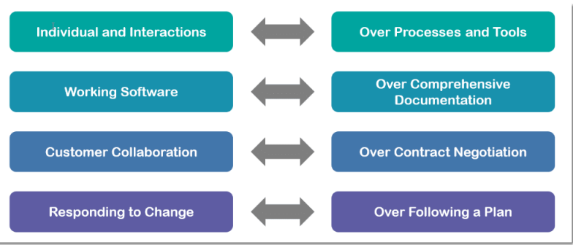
Agile Manifesto/Values

Slide 4

Agile Principles
1.Highest priority is to satisfy the customer. 2.Changes in requirements are Allowed. 3.Deliver working software frequently.
4.Continuous Interaction between Business people and Agile team.
5.Every Individuals Build the projects As responsible.
6.Self-organizing teams.
7.Agile team do prefer face-to-face conversation. 8.Working software is the primary object.
9.Able to maintain a constant working pace(40hours in a week). 10.Continuous attention to technical excellence. 11.Simplicity – the art of maximizing the amount of work not done – is essential. 12.The team reflects on how to become more effective.

Slide 5
User Story
A feature or module in a software/small unit in the product development
Epic
Epic is collection of the of all user stories/large requirement software development
Task
An action to be perform on user stories by Scrum team

Slide 6
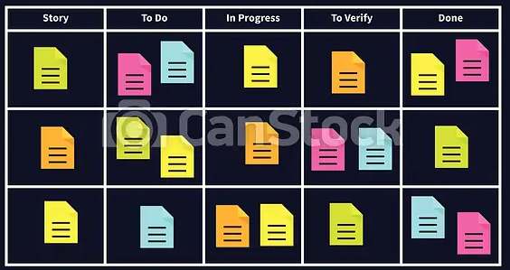
Scrum Task board

Slide 7
Definition of Ready(DoR)
User Story Should be Clear
User story is testable & Feasible
User Story should be with acceptance criteria
Team as a good idea what will mean to Demo the user story
Dependencies of user story should be clear
Note: This is user story level Characteristics

Slide 8
Definition of Done(DoD)
User Story Should be developed by developer
Unit testing should be completed
Integration testing should be completed
Test cases were created
Smoke ,sanity & regression testing completed
Bugs should be fixed
Testing phase also completed
Demo about the software working should ready and completed
Note: This about to delivery of the build

Slide 9
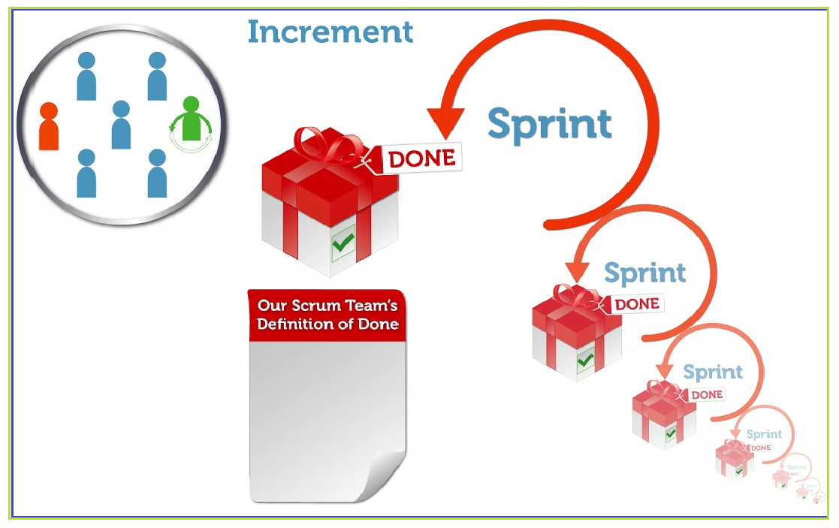
Product Increment

Slide 10
Any Queries?

Slide 11
Why Swhizz?
Following the project-oriented training By working on user stories
Real time people will deliver the classes
Hands on experience.
One to One monitoring
Interaction sessions
Doubts Clarification Session
Expertise in resume preparation
Mock interviews
Job assistance
Associated with 50+ Clients
900+ students got placed

Slide 12
Thank You
Mr.SubbaRao (Relationship Manager)
Contact:9059002244

